Slide 1


ECEN 403 Midterm Presentation Team 60: Solar Lighting System Josh George, Lyric Haylow, Tyler Livingston, Jeb Malek Sponsor :Dr. Jang

Slide 2

Problem At Hand
As power systems begin to move away from nonrenewable energy sources, a need for a clean, renewable source becomes more apparent than ever. 85% of the world's energy comes from nonrenewable sources, sources that will eventually be depleted.

Slide 3
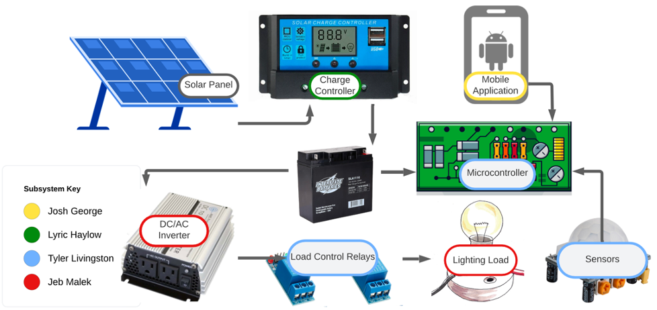
Problem Overview
For our project, we will design a home lighting system that operates a variety of lights throughout both an inside foyer and an outside patio. The separate parts for the system to be considered are the battery, power conversion and regulation, mobile application functionality, BT microcontroller, and motion and light sensors for automated switching.

Slide 4
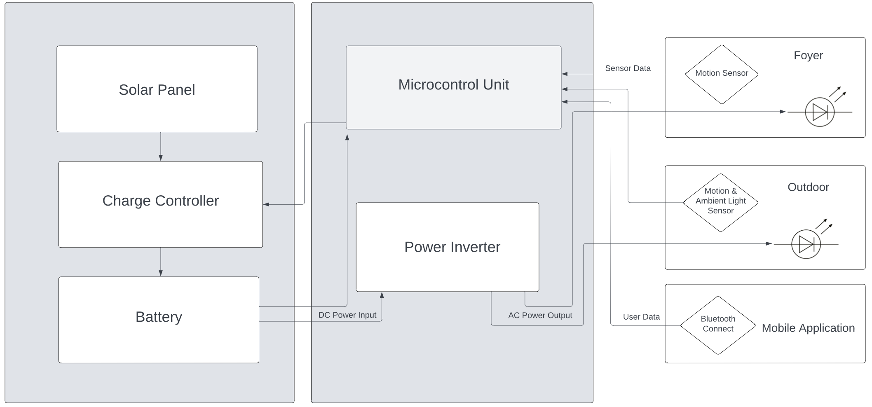
Subsystem Description

Slide 5
Task Partition
Lyric: Design and implement a charge controller to regulate the power that charges the battery from the solar panel.
Jeb: Design a power inverter to send power from the battery to the lights.
Tyler: Design and develop a control unit to control lights based on user preference.
Josh: Create a mobile application that can monitor and manipulate the entire lighting system per manual direction.

Slide 6
Solar Charge Controller Unit
Solar Panel: Sunforce 18 Watt 12-Volt Solar Panel, will provide average of around 15V to charge controller.
Battery: Interstate 12V 18Ah Battery, Lead Acid Rechargeable. Has a total of 216Wh available.
Charge Controller:
Chosen design: BQ24650 Stand-Alone Buck Battery Charge Controller for Solar Power with Maximum Power Point Tracking
Essentially regulates how much power is being fed to the battery. Buck Battery charge controller ensures that if voltage goes too high or low, adjusts it to fit expected value for the battery.

Slide 7
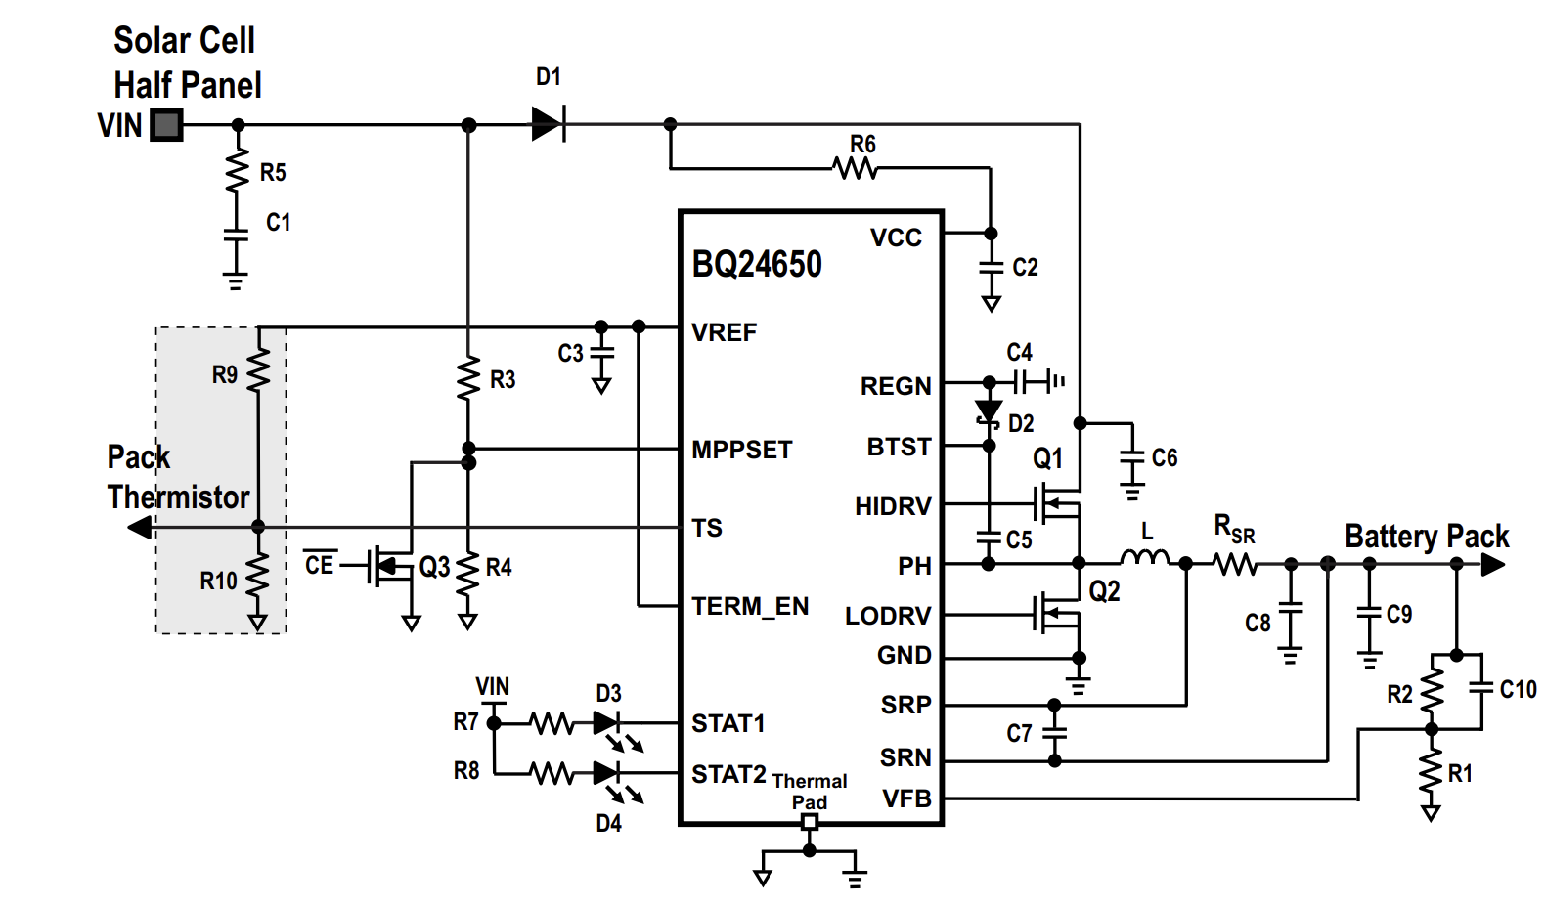
Typical Application and Design

Slide 8
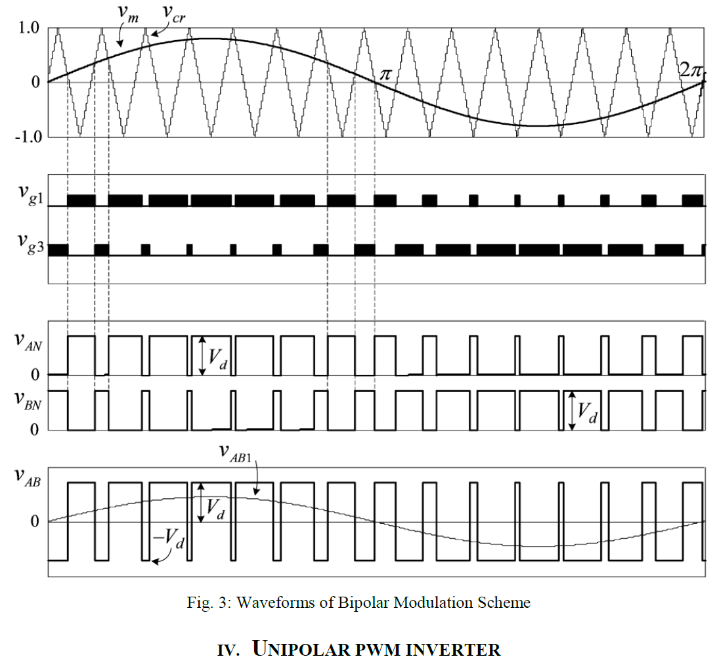
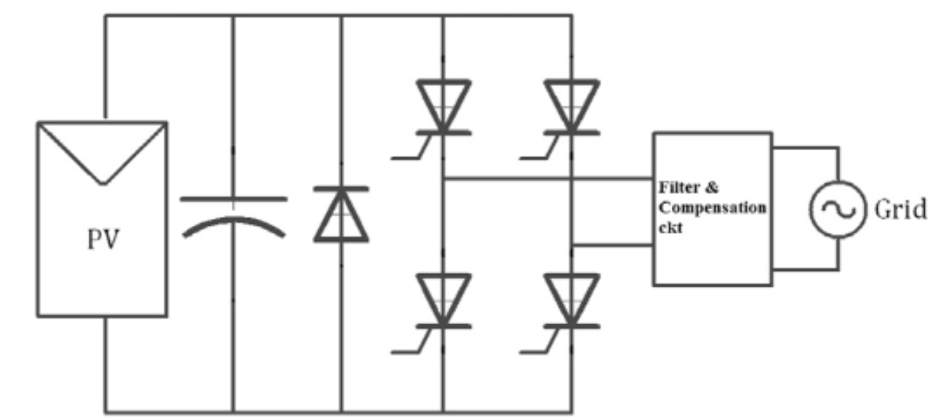
Power Inverter
Single Stage Line Commutated Pure Sine Wave Inverter , 2 Half Bridge Driver Chipsets
Unipolar PWM Switching
Nominal Rated: 110-120 VAC 200W
Power Transformer: 1/10 Turns Ratio
On 0.01 sec, Off 0.01 sec ,
S1 S3 Pos ½ Cyc , S2 S4 Neg ½ Cyc.
LM2501 (half bridge gate driver)
Pos ½ Cyc. Pulse, Neg ½ Cyc Pulses from
Comparator
LM339B
Notes:
AND operator for signal at particular timing, comparator , using a triangular wave with , using the comparator and the triangle wave , pulses can be created

Slide 9
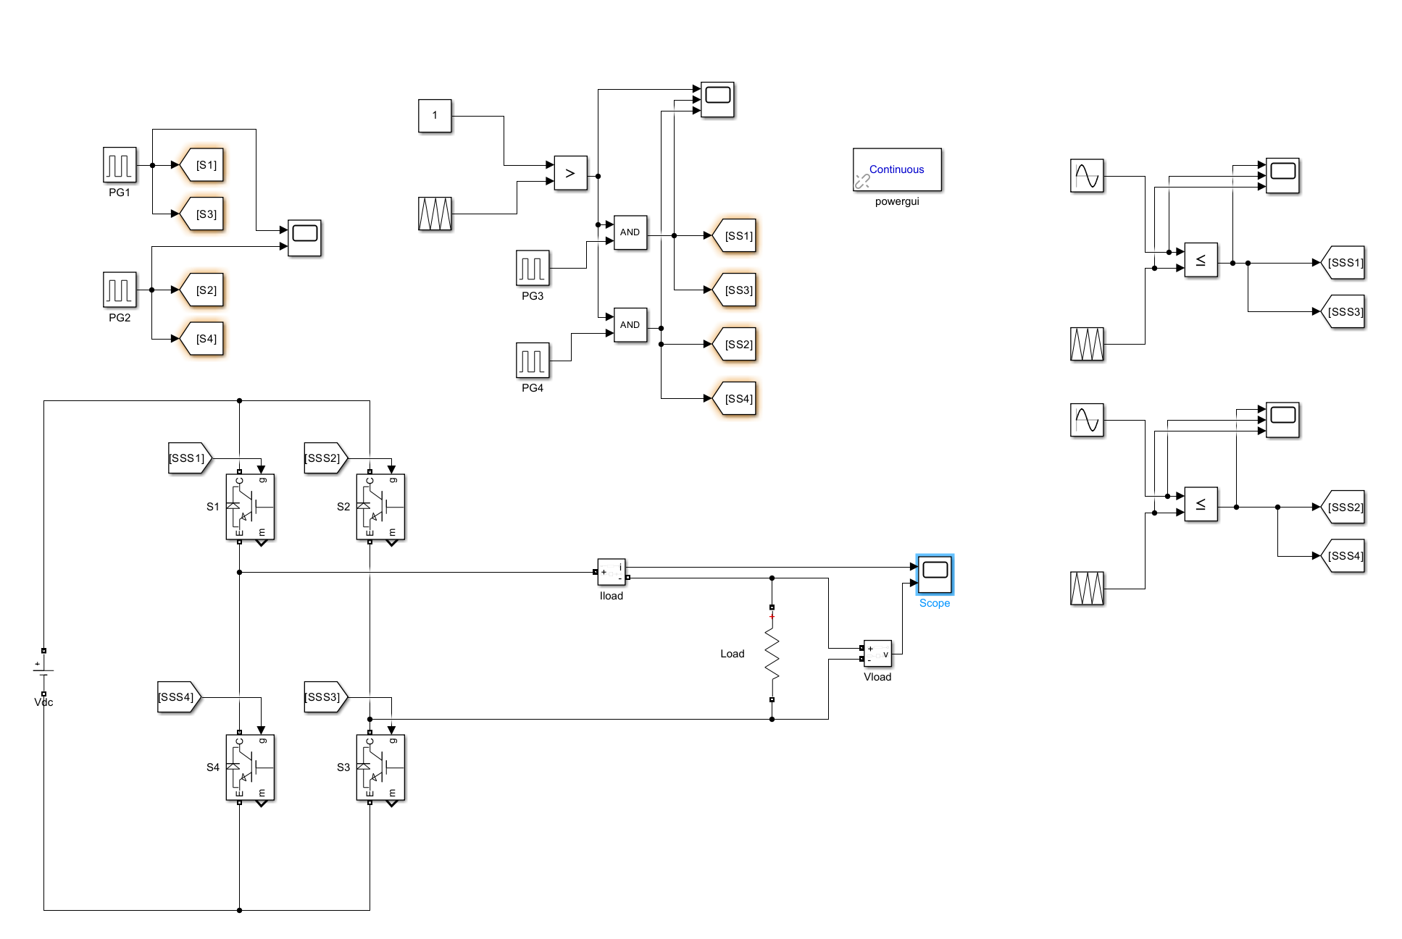
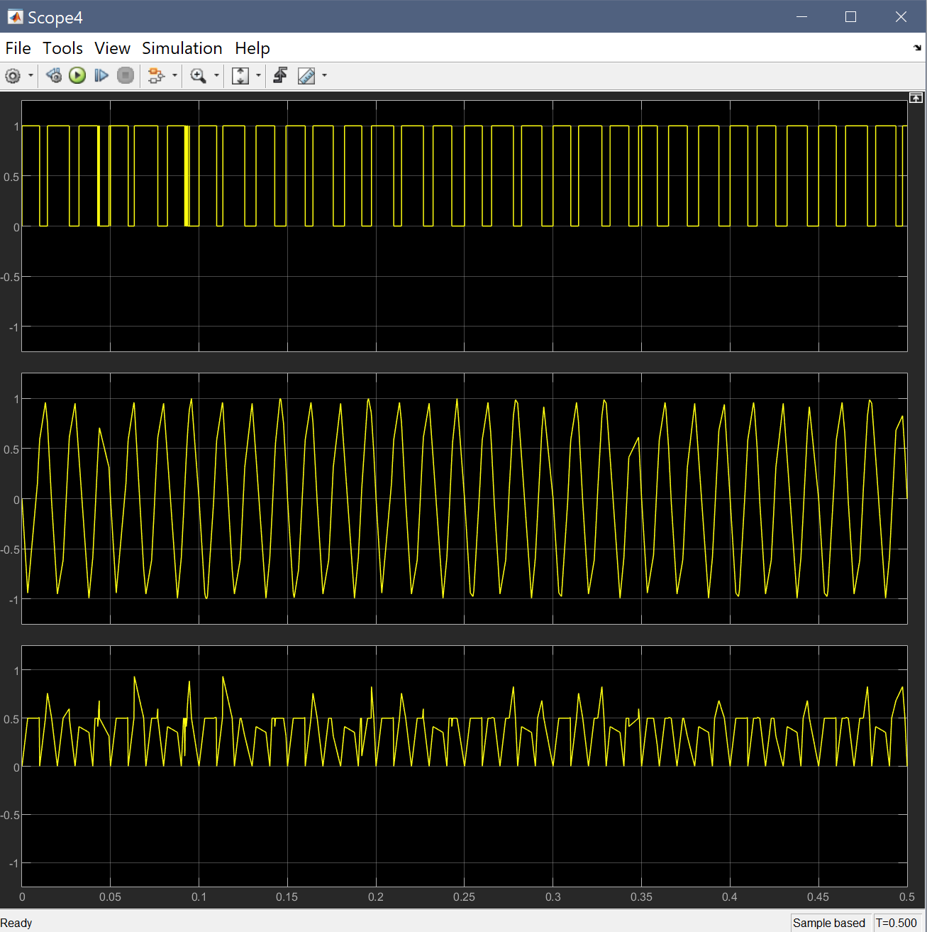
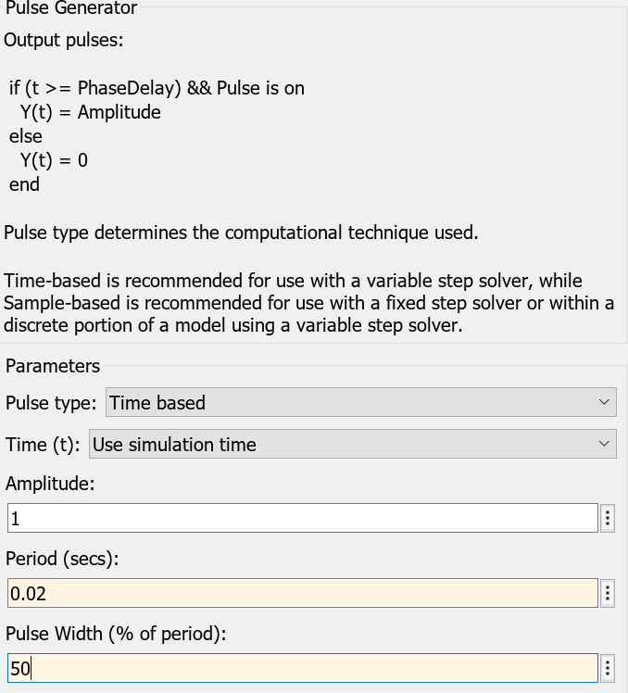
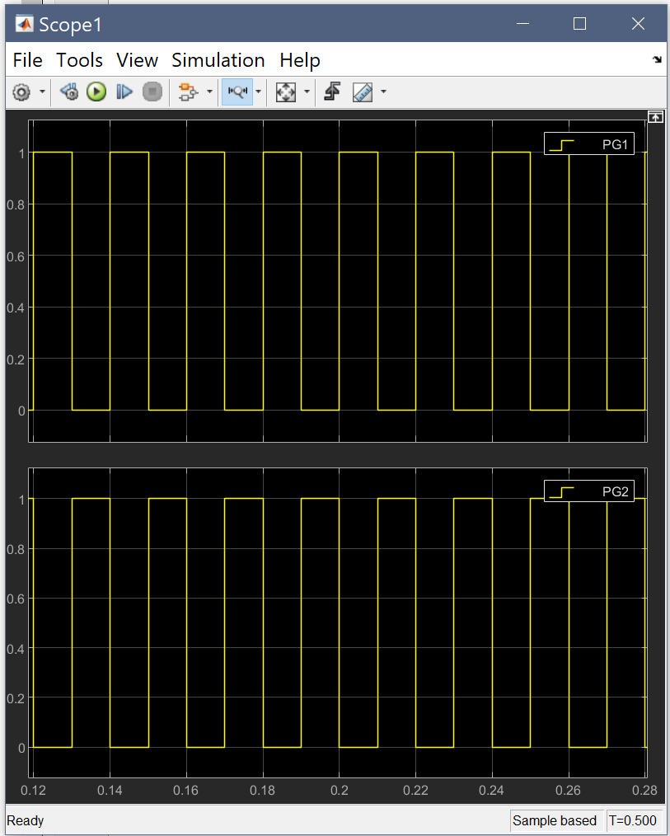
Simulation
VCVS: Simulating Switching MOSFET
Comparators: Generating Unipolar Switching
AC Current Created with
Looking to Achieve 8% THD Based on
Continuing Research into BenchVue E-Load ,
Following IEEE 1547-2018 Interconnection of Distributed Energy
IEEE
Notes:
50 percent on 50 percent off, half on , half off

Slide 10
Microcontroller and Sensors
Overview:
The MCU must take in sensor data and send signals to control the lights based on user preference from the mobile app.
Considerations:
Bluetooth connection to mobile app.
Multiple GPIO ports for sensors.
SPI/I2C to communicate with sensors.
FOV of PIR sensors.
Foyer: Smaller FOV to reduce activation from small pets
Patio: Larger FOV for increased coverage
Range of PIR sensors.

Slide 11
Microcontroller and Sensors
Current Progress:
Finalized MCU power supply design.
Schematic design.
Next steps:
Finish and review schematic design.
Design PCB and order.
Components | Part Number
MCU Module | ESP32-WROVER-E-N16R8
2.2m PIR Motion Sensor | EKMB1393111K
17m PIR Motion Sensor | EKMB4303111K
Ambient Light Sensor | APDS-9306-065

Slide 12
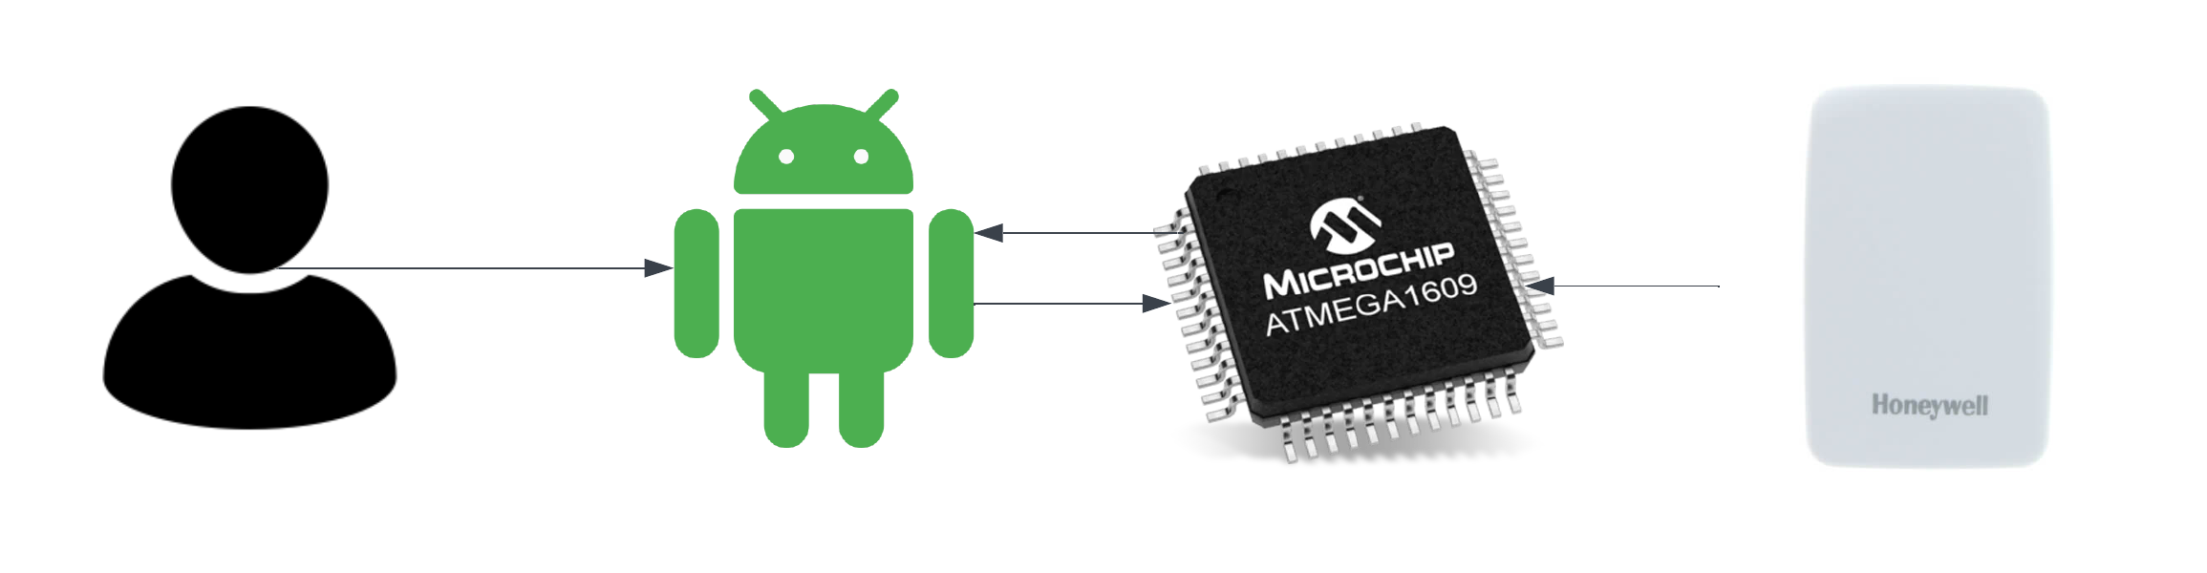
Mobile Application
Provides primary user interface for SLS
Programmed with Kotlin through Android Studio
Set user preferences, display battery/light data, display weather data
Connects to microcontroller serial port
Bluetooth connection

Slide 13
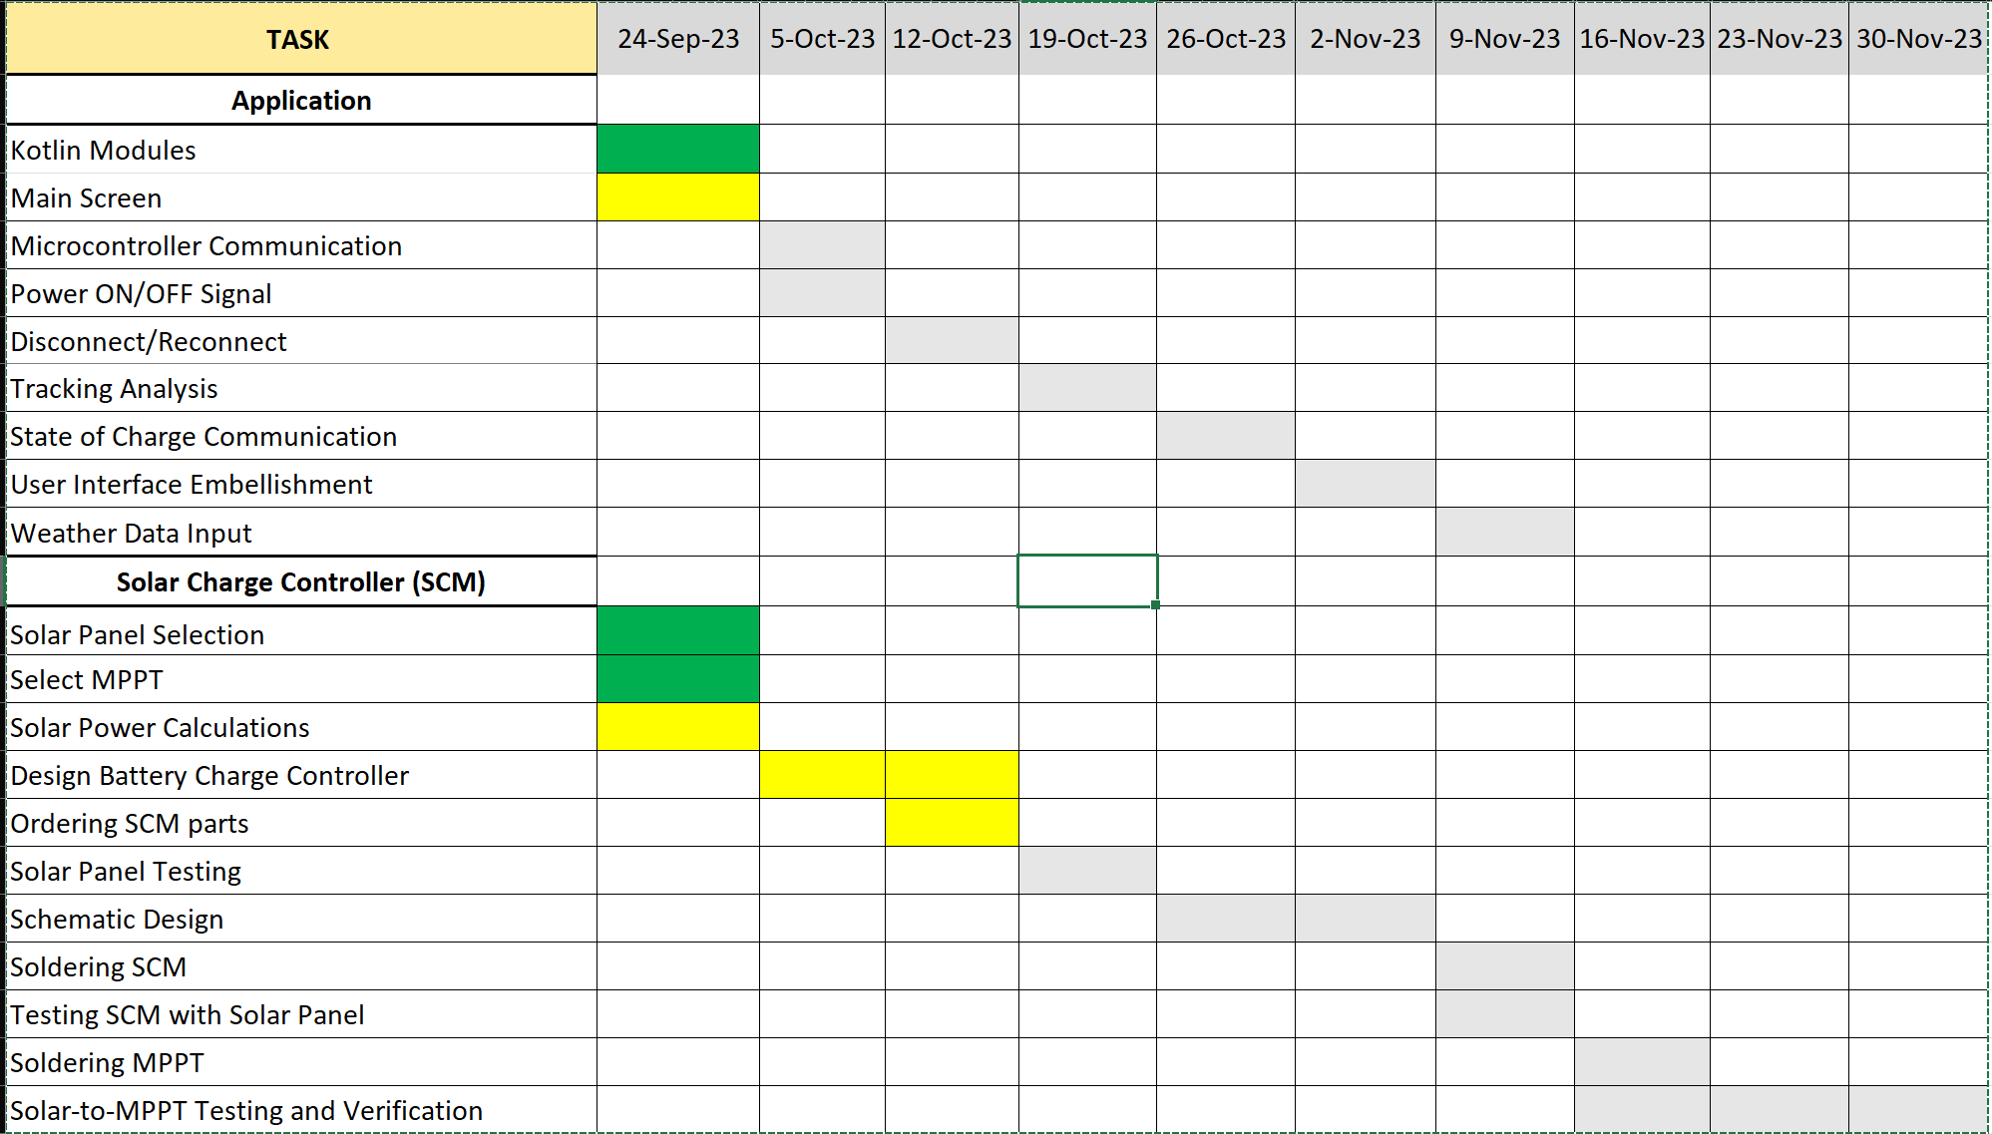
Execution Plan 1/2

Slide 14
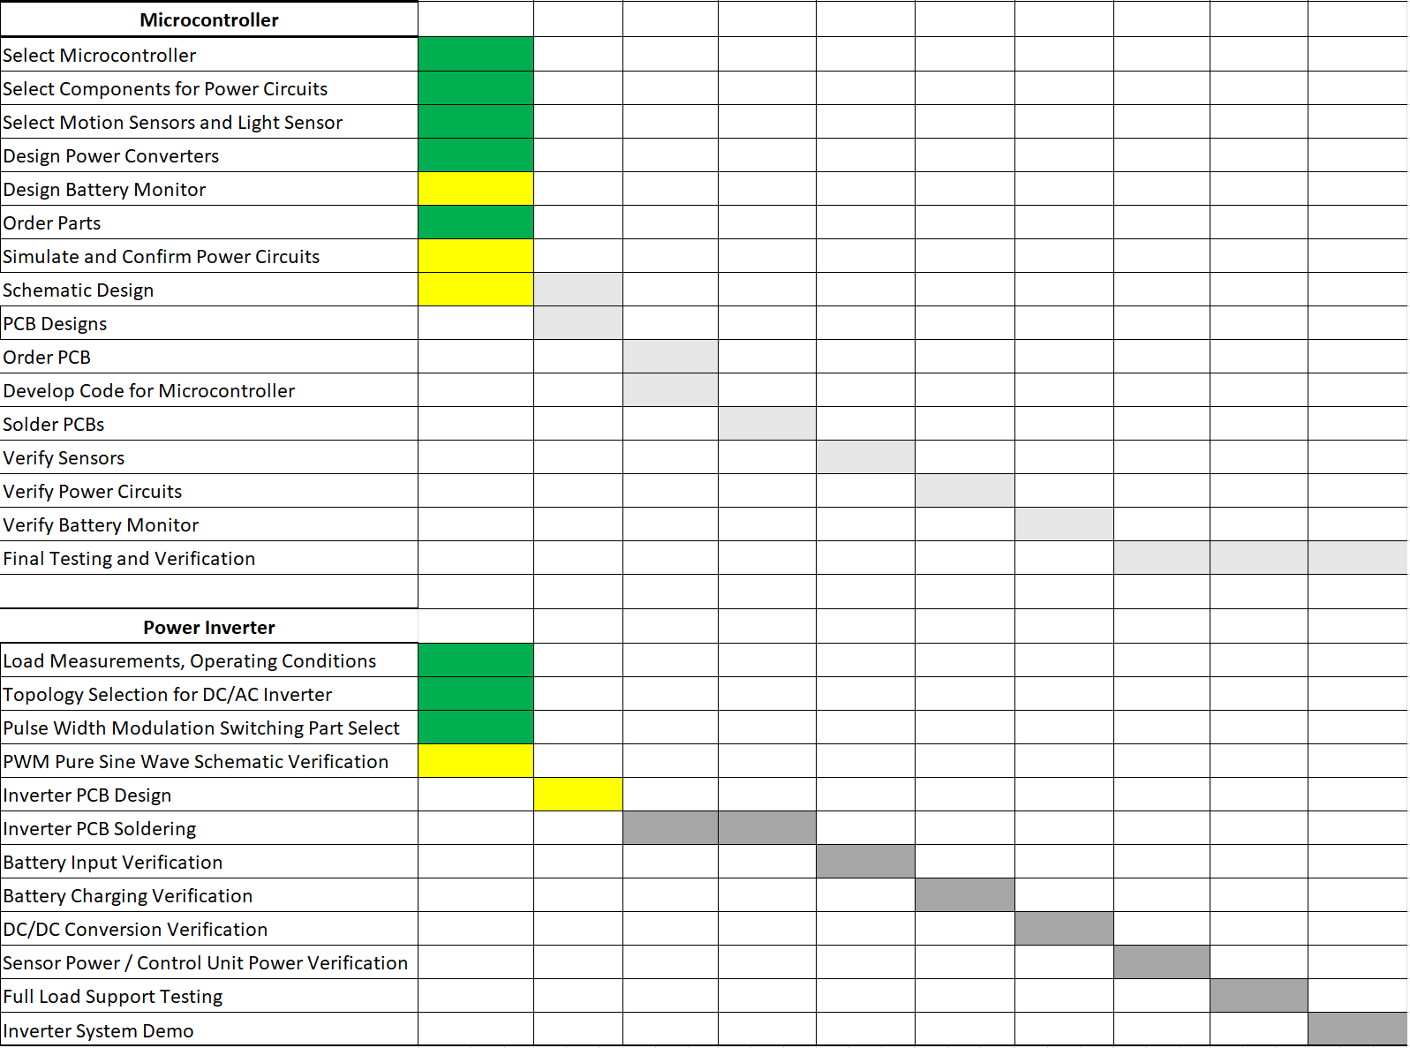
Execution Plan 2/2

Slide 15
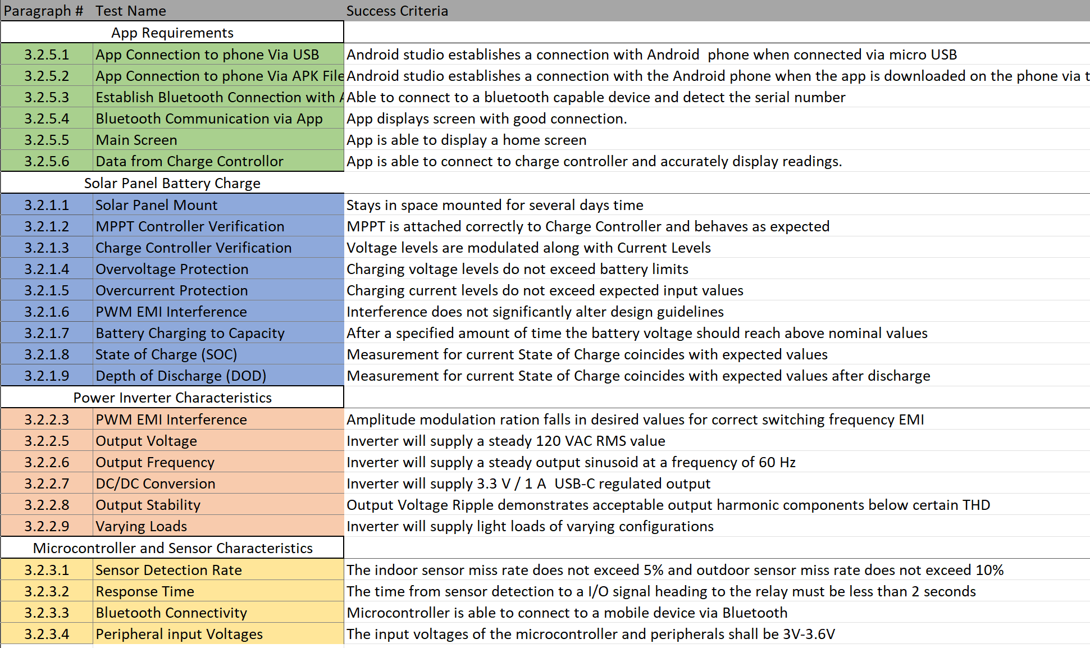
Validation

Slide 16
